Slide 1
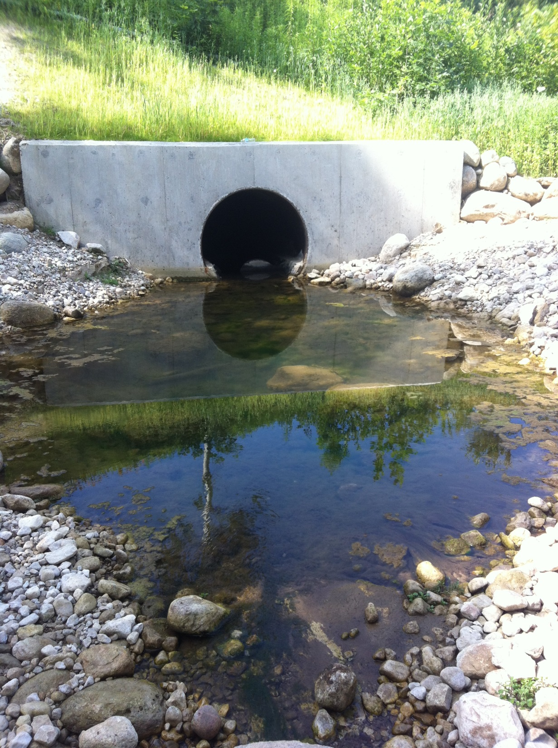
Wildlife conservation enhanced fish passage
Transportation association of Canada
Presented by:
Kirstie Houston, Environmental Planner
MTO West Region
September 2016

Slide 2
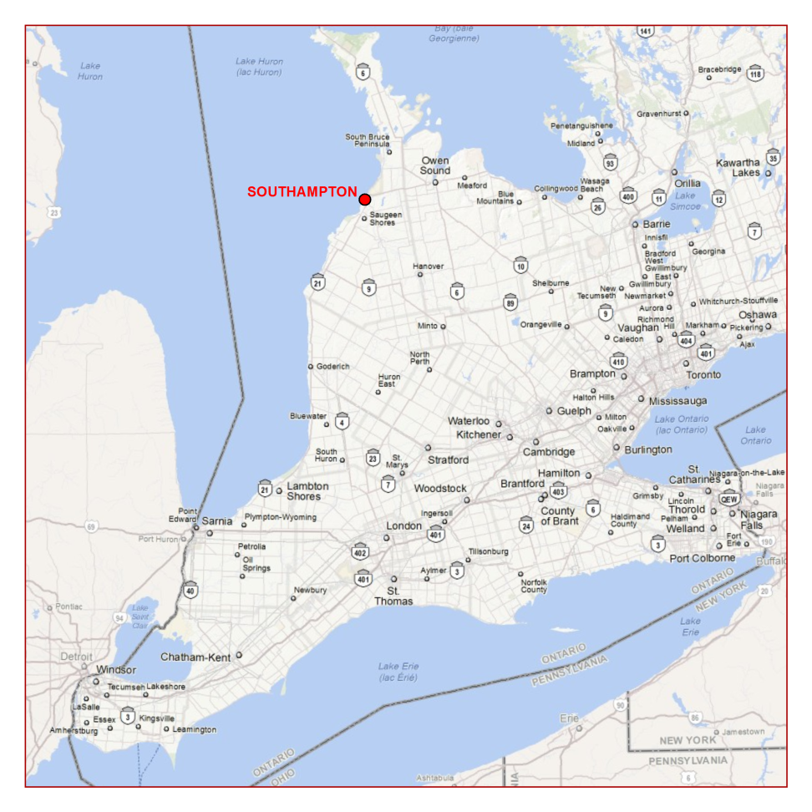
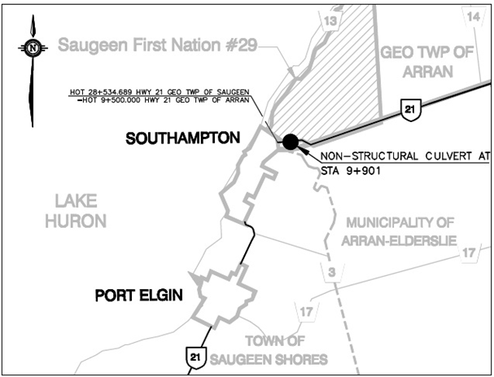
Highway 21
Saugeen First Nation Reserve #29

Slide 3
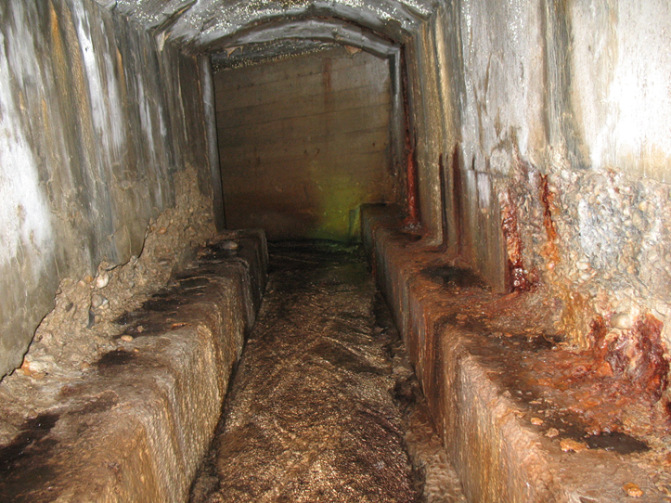
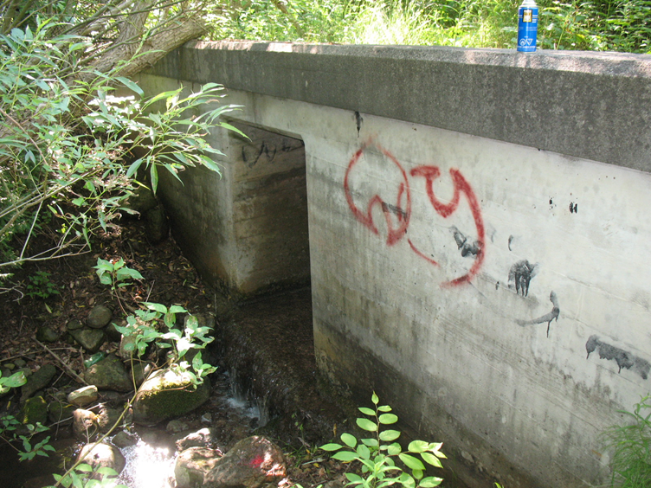
Original Culvert
Perched above the stream bed
Restricted any upstream fish migration
Severe deterioration
Photos courtesy of Parsons

Slide 4
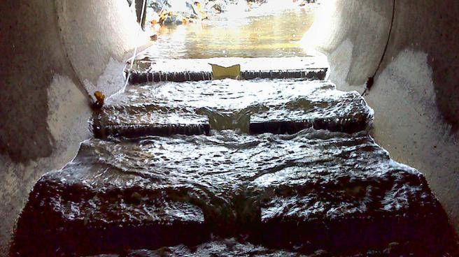
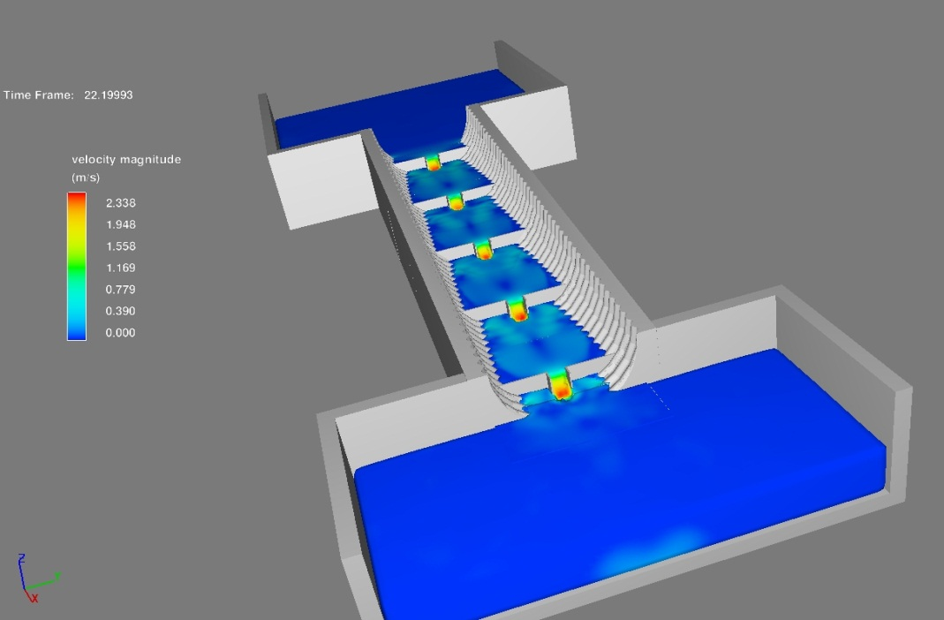
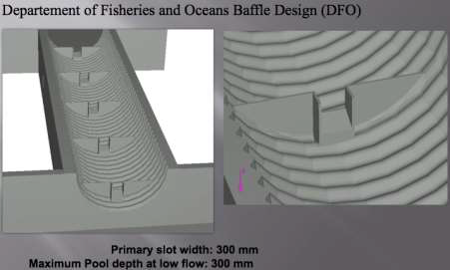
Fish Passage – DFO Design
DFO Design:
Standard design
Higher velocities down centre of pipe
Illustration courtesy of CSPI

Slide 5
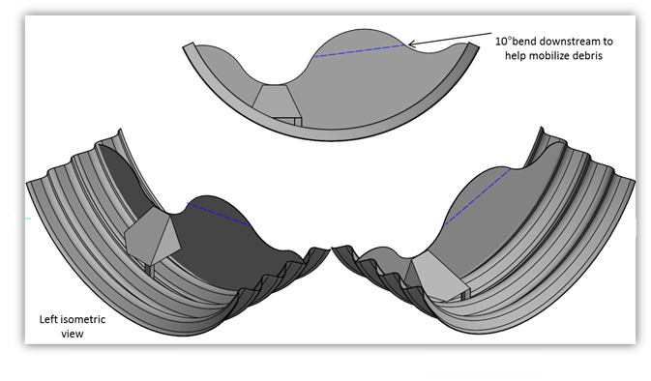
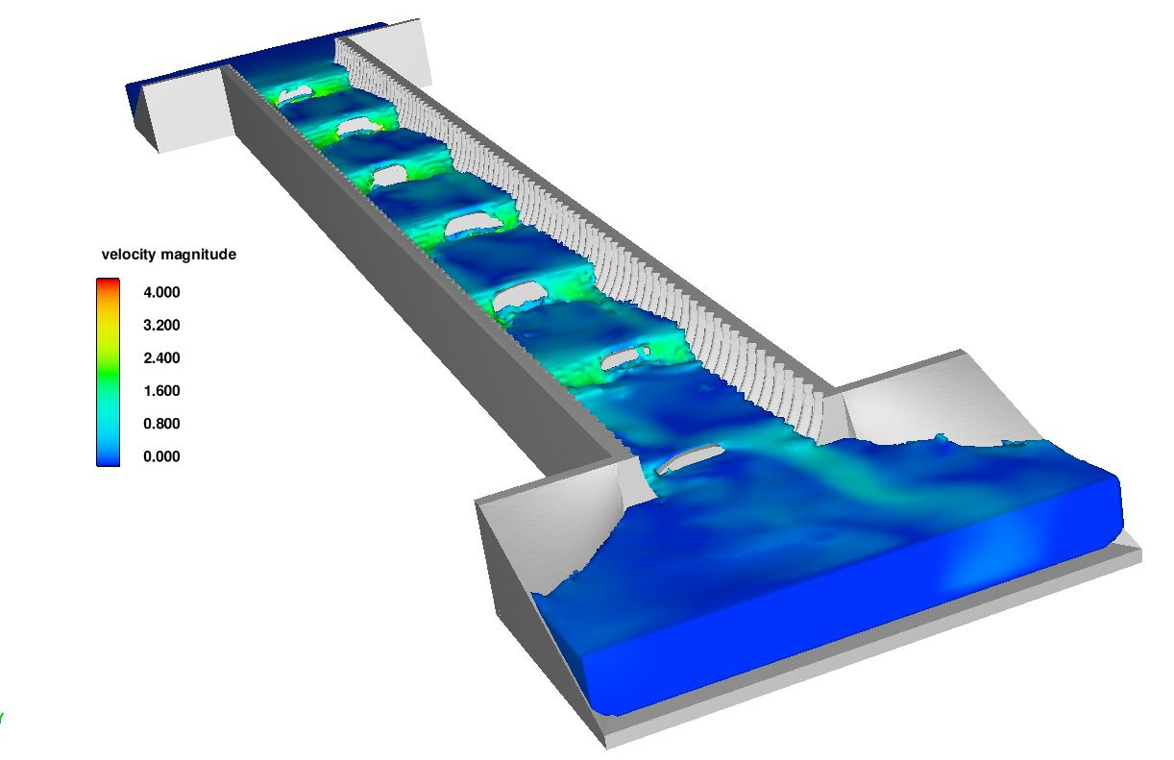
Fish Passage - Innovation
Innovative design
Creates a more natural meander through culvert
Illustrations courtesy of CSPI

Slide 6
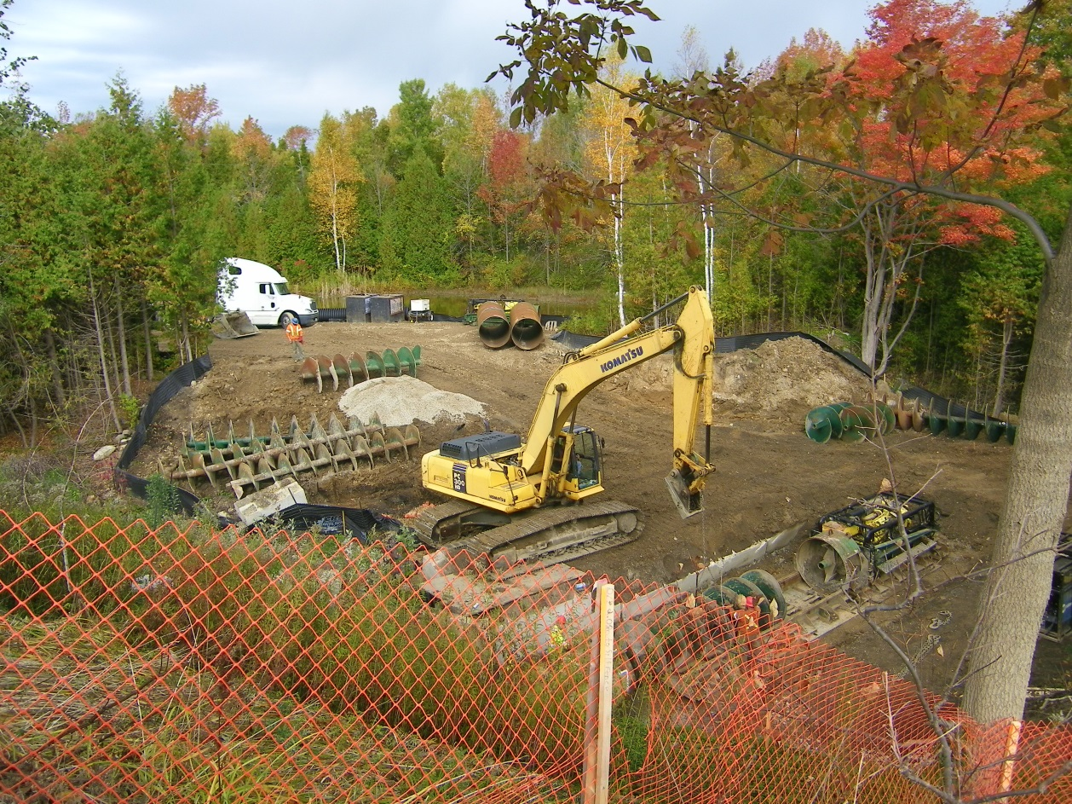
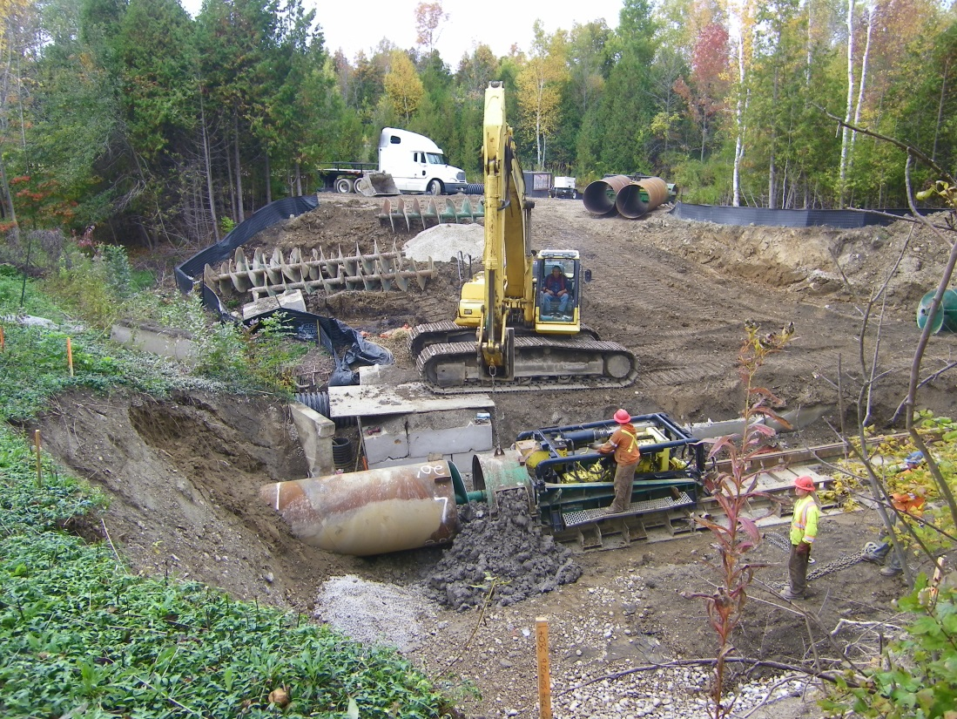
Construction: Pipe installation
Fall 2015

Slide 7
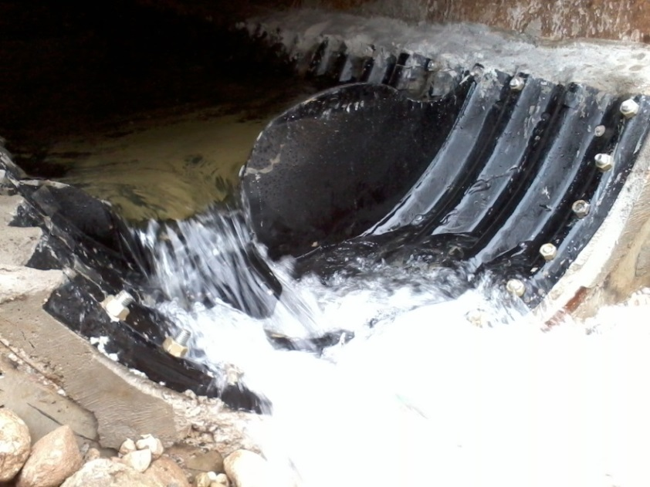
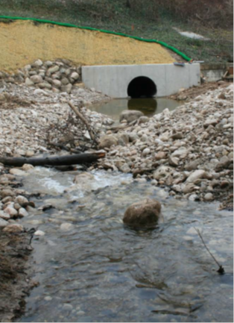
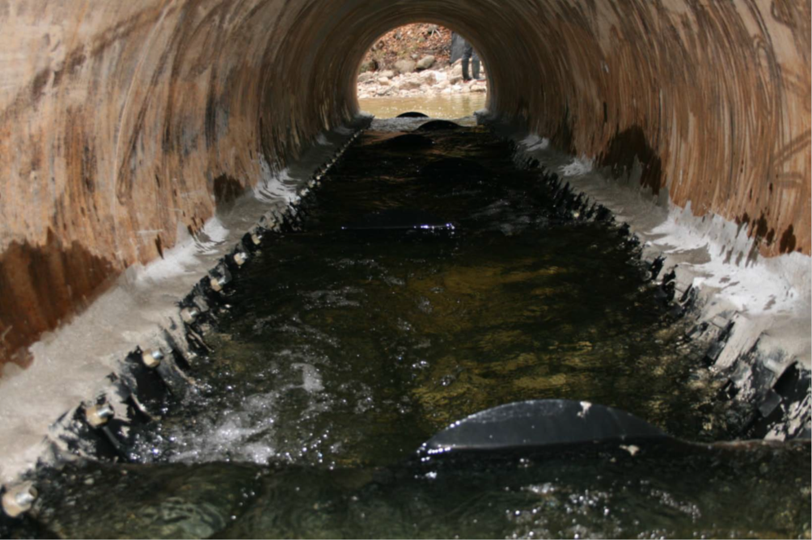
New Culvert
Eliminates barriers to fish migration
Increased range for sensitive species
Expanded the habitat of a valuable resource to First Nations
Photos courtesy of CSPI

Slide 8
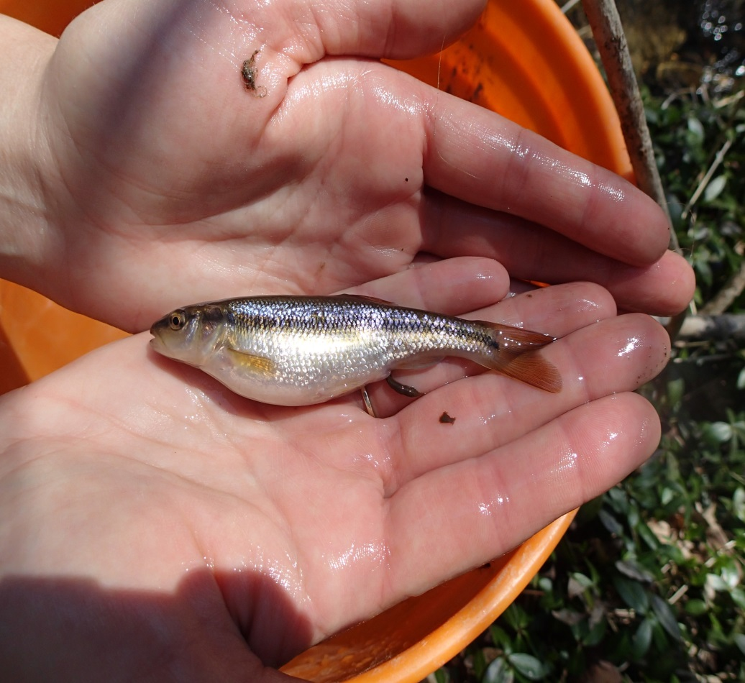
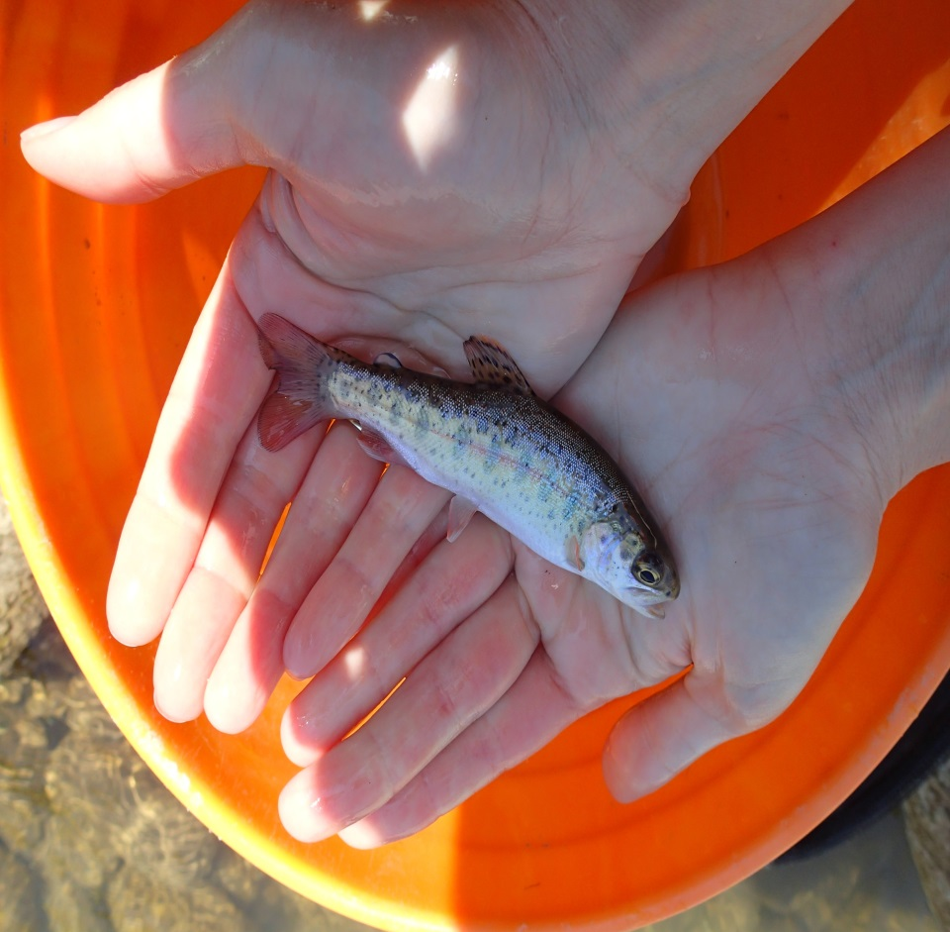
Post-construction Monitoring
Post-construction monitoring was conducted in Spring and Summer of 2016 and will continue again in 2017 to determine fish use of the culvert as well as proper functioning of the stream.
Photos courtesy of Parsons

Slide 9
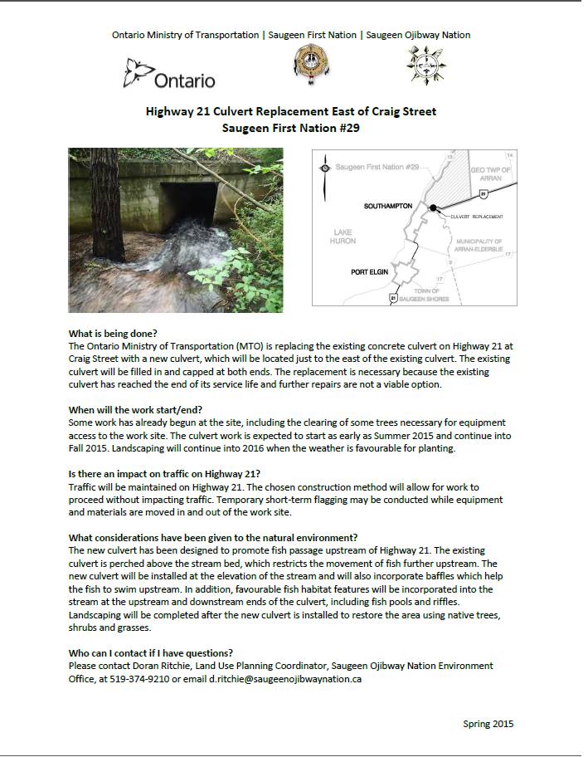
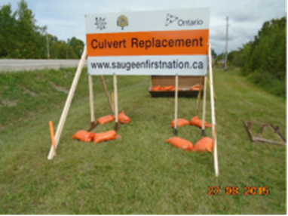
First Nation Engagement
Consultation with SON Environment Office
Presentations to SFN Council, Information brochure posted on SFN website; sign erected at site
Aboriginal Procurement Projects
Relationship building

Slide 10
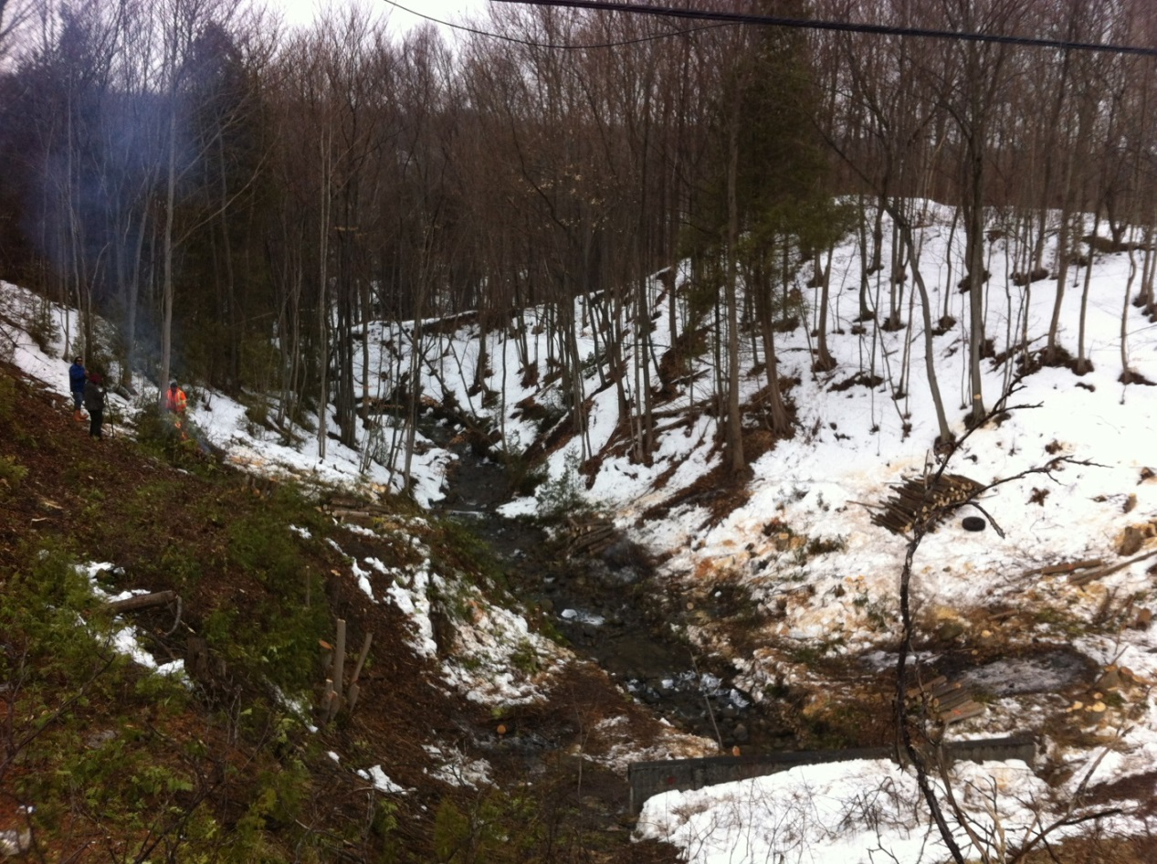
Pre-Clearing of Trees
Hired local Saugeen First Nation community members

Slide 11
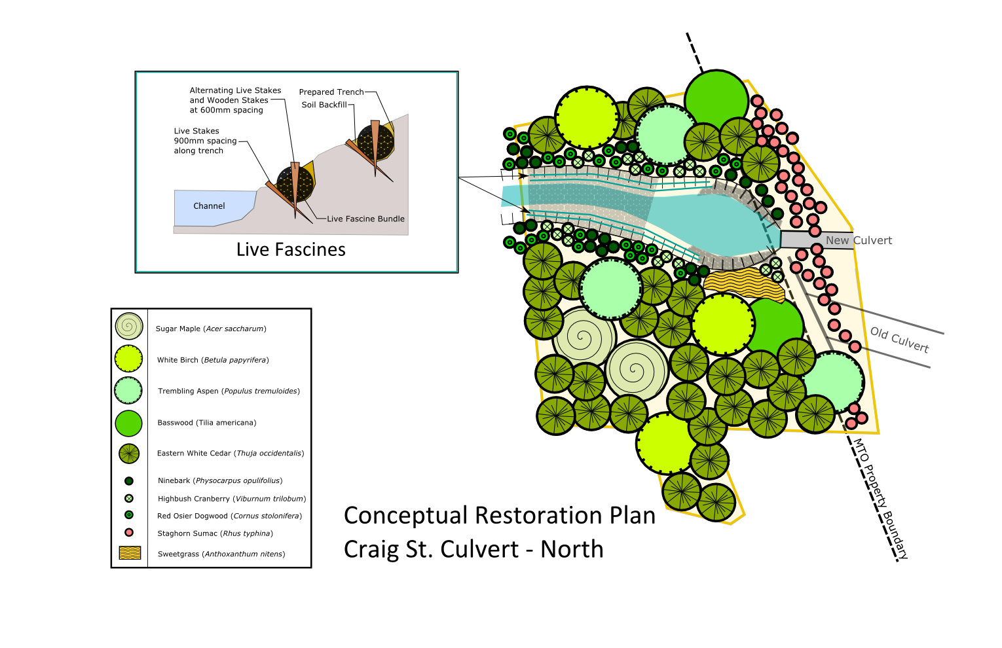
Site Restoration – North
Design courtesy of Parsons

Slide 12
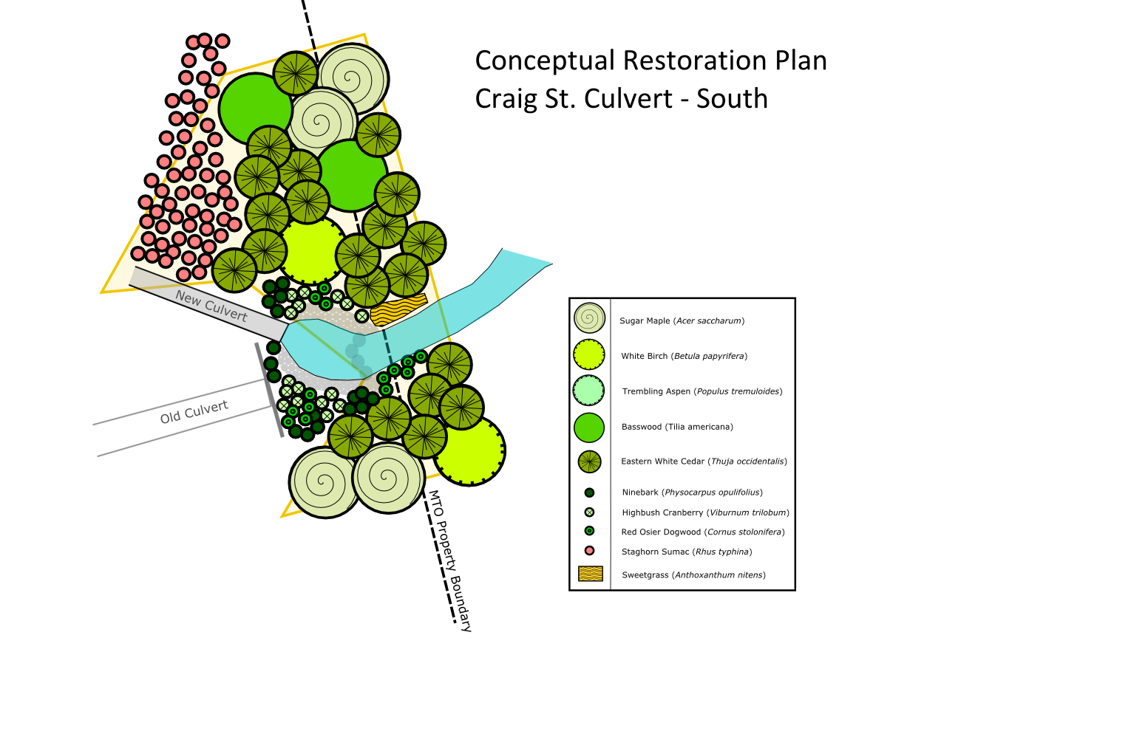
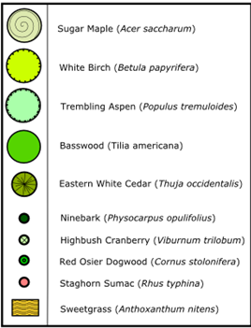
Restoration – South
Design courtesy of Parsons

Slide 13
Project Team
Baffle Design by:
Ken Hannaford, Environmental Scientist, Government of Newfoundland and Labrador
Modelling by:
Jason Duguay, Civil Engineering PhD candidate, University of Sherbrooke
MTO
Project Engineer: Valerie Nantais
Environmental Planner: Kirstie Houston, Adele Mochrie
CSA: Jonathan Wilson
Saugeen Ojibway Nation
Land Use Planner:
Doran Ritchie
CSPI
Dave Penny, Executive Director Emeritus
MMM
Consultant Project Engineer:
Dan Green
Parsons
Fisheries and Terrestrial Services:
Tisha Doucette
Courtney Beneteau
Julie Scott
Aquafor Beech
Fluvial Geomorphologist:
Rob Amos
Construction by:
The Murray Group
Contract Administration by:
Noveen

Slide 14

Thank You!
Kirstie Houston
Environmental Planner
Ministry of Transportation
West Region, Environmental Section
519-873-4563
Kirstie.Houston@ontario.ca

